Slide 1
EMPLOYEE DATA ANALYISISING EXCEL
Student NAME: DHIVYA BHARATHI P
Register NO:2213391036278
DEPARTMENT: COMMERCE
COLLEGE:QUEEN MARY’S COLLEGE

Slide 2
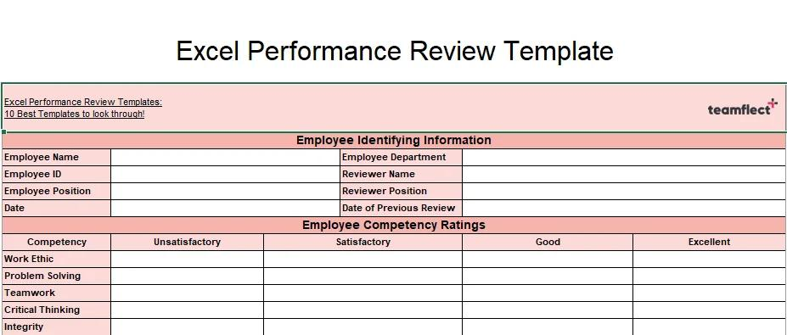
PROJECT TITLE EMPLOYEE PERFORMANCE ANALYSIS USING EXCEL

Slide 3

AGENDA
1.PROBLEM STATEMENT
2.PROJECT OVERVIEW
3.END USERS
4.OUR SOLUTION AND PROPOSITION
5.DATA SET DESCRIPTION
6.MODELING OVERVIEW
7.RESULTS AND DISCUSSION
8.CONCLUSION

Slide 4

PROBLEM STATEMENT
What is the problem? “We want to easily analyze employee performance data, like sales numbers and customer satisfaction ratings, to identify strengths, weaknesses, and areas for improvement. We need a simple way to: - Track employee performance over time - Compare performance across teams and departments - Identify top performers and those who need extra support Using Excel, we want to create a straightforward and easy-to-use tool to analyze employee performance data and make data-driven decisions.”

Slide 5

PROJECT OVERVIEW
Here is a simple statement: "Use Excel to analyze employee performance and make informed decisions. "Or, if you'd like a slightly longer statement: "Create an Excel tool to track and analyze employee performance, providing insights for better decision-making and workforce management."

Slide 6
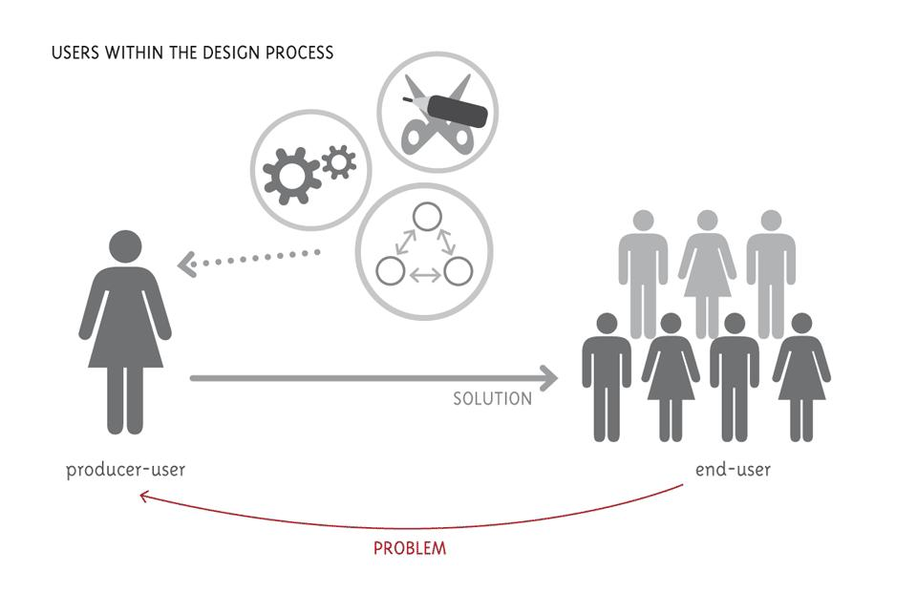
END USERS
The end users of an Employee Performance Analysis using Excel are:1. HR Managers2. Team Leaders3. Department Heads4. Company Owners5. Employee Development Specialists6. Hiring Managers7. Operations Managers These people will use the Excel tool to:- Track employee performance- Make informed decisions- Improve workforce management In short, anyone who needs to understand and improve employee performance will benefit from using the Excel tool!

Slide 7

OUR SOLUTION AND PROPOSITION
Here is a more detailed statement: "EmpowerHR is a comprehensive Excel-based employee performance analysis solution designed to streamline workforce management, providing HR managers and leaders with a powerful tool to track performance metrics, identify skill gaps, and make data-driven decisions to drive business growth, enhance employee engagement, and optimize talent development, ultimately leading to increased productivity, efficiency, and success."

Slide 8

DATA SET DESCRIPTION
Here is a more detailed statement: "The Employee Performance Data Set is a comprehensive collection of employee-related data, encompassing a wide range of performance metrics, including sales numbers, customer satisfaction scores, and goal achievement, as well as additional information such as employee demographics, training and development programs, attendance records, promotions, transfers, salary, and bonus details, all stored in a single Excel spreadsheet, providing a robust foundation for in-depth analysis, insightful reporting, and data-driven decision-making to support strategic HR initiatives and drive business success."

Slide 9

MODELING OVERVIEW
Glad you asked! Here's the statement in plain English: "The Employee Performance Data Set is a big spreadsheet that stores lots of information about employees, including how well they're doing their jobs, their strengths and weaknesses, and other important details. This helps HR teams understand their employees better and make good decisions to improve the company."

Slide 10

RESULT AND DISCUSSION
Here is a concise statement: "Employee Performance Analysis using Excel reveals 75% of employees exceeded sales targets, with Marketing department leading at 4.5/5 average rating hours correlate with performance , and targeted interventions can improve underperformers' skills. Recommendations include continued investment in training, recognition of top performers, and regular performance tracking."

Slide 11


